Slide 1
MUSIC STORE ANALYSIS
SQL PROJECT BY ADITYA D GAYEN

Slide 2
OVERVIEW
Utilize the power of SQL to embark on a comprehensive journey through the digital music store database.
Extend a gentle hand to stakeholders, offering them insights finely tuned to their needs for thoughtful decision-making.
Explore geographical growth patterns, purchasing power variations, and total revenue trends.
Identify the most profitable city in terms of revenue generation and the highest-spending customers.
Provide actionable recommendations tailored to drive business growth and optimize performance metrics.

Slide 3
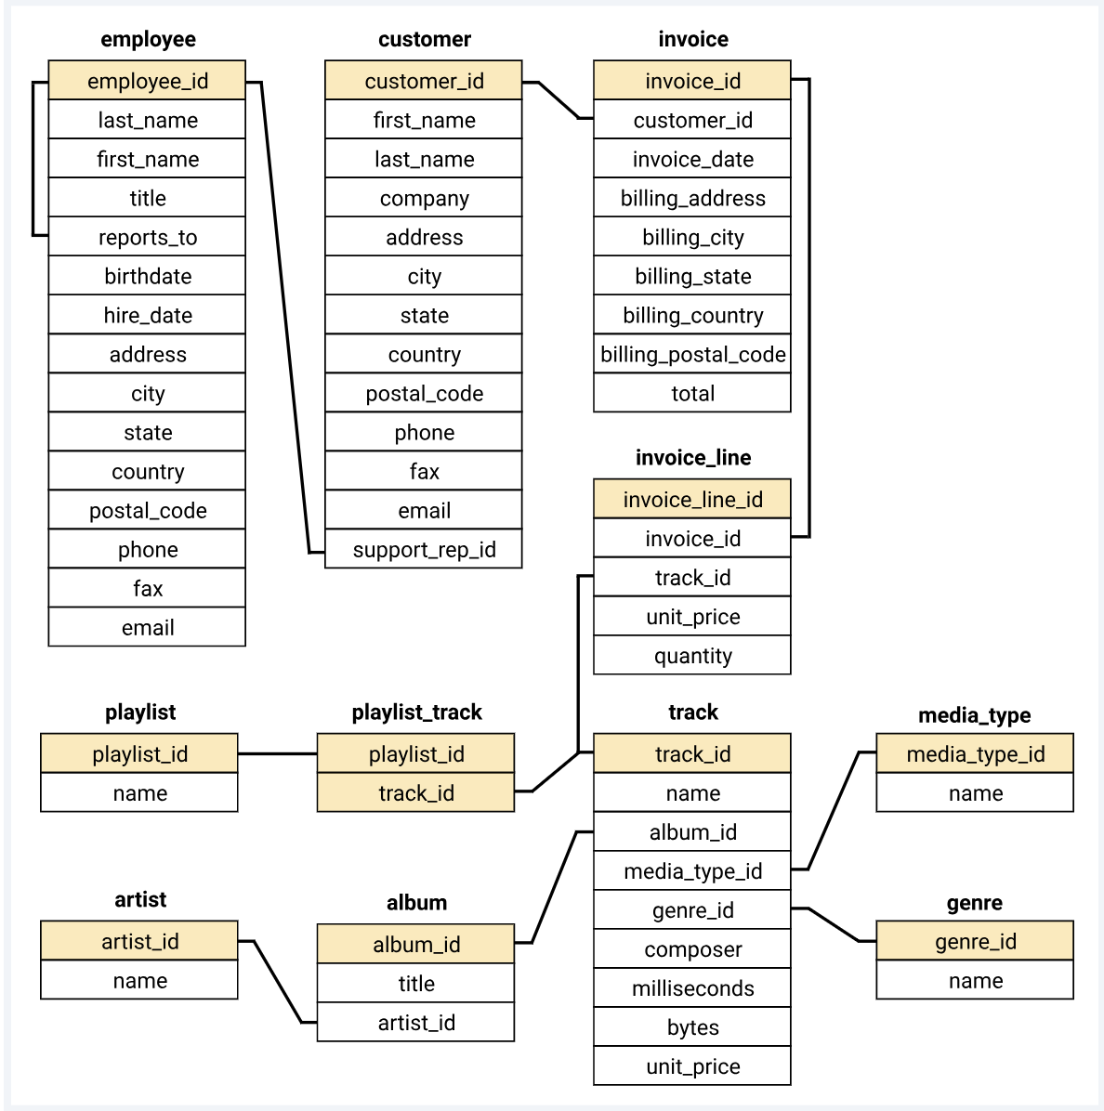
SCHEMA DIAGRAM
A schema diagram visually displays a database's structure, including tables, columns, and their relationships. It acts as a blueprint for understanding data organization, aiding in database design, development, and maintenance. This clear overview supports efficient data management and informed decision-making for administrators, developers, and stakeholders.

Slide 4
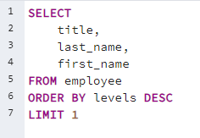
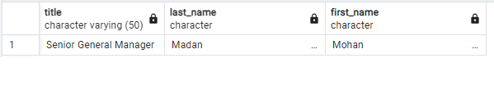
EASY
Who is the senior most employee based on job title?
QUERY
Table

Slide 5
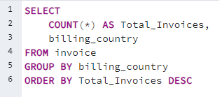
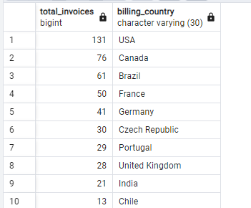
EASY
Which countries have the most Invoices?
QUERY
Table

Slide 6
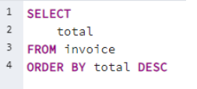
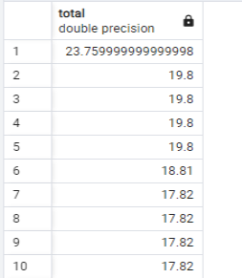
EASY
What are top 3 values of total invoice?
QUERY
Table

Slide 7
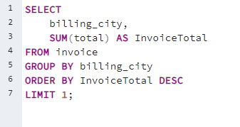
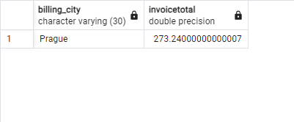
EASY
Which city has the best customers? We would like to throw a promotional Music Festival in the city we made the most money ?. Write a query that returns one city that has the highest sum of invoice totals. Return both the city name & sum of all invoice totals
QUERY
Table

Slide 8
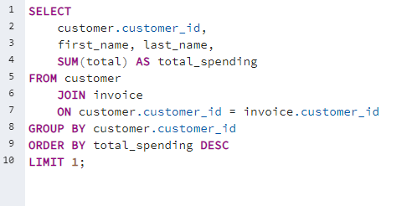
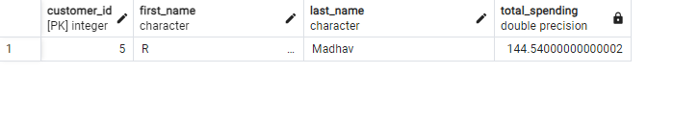
EASY
Who is the best customer? The customer who has spent the most money will be declared the best customer? Write a query that returns the person who has spent the most money
QUERY
Table

Slide 9
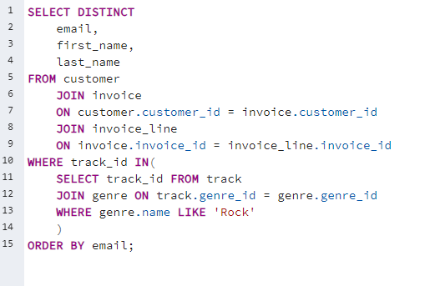
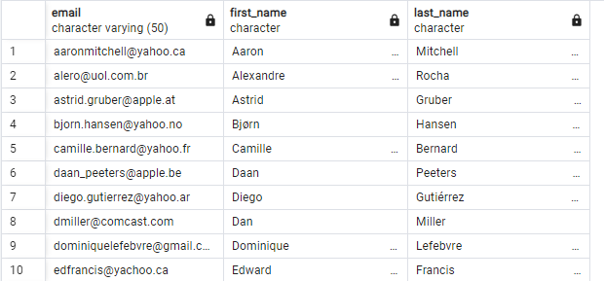
MODERATE
Write query to return the email, first name, last name, & Genre of all Rock Music listeners. Return your list ordered alphabetically by email starting with A.
QUERY
Table

Slide 10
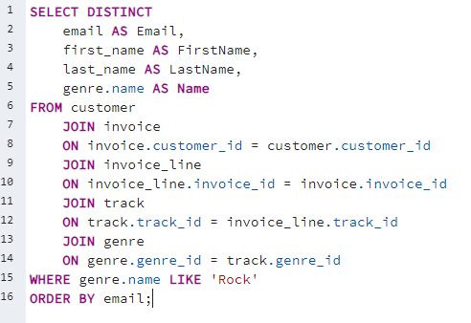
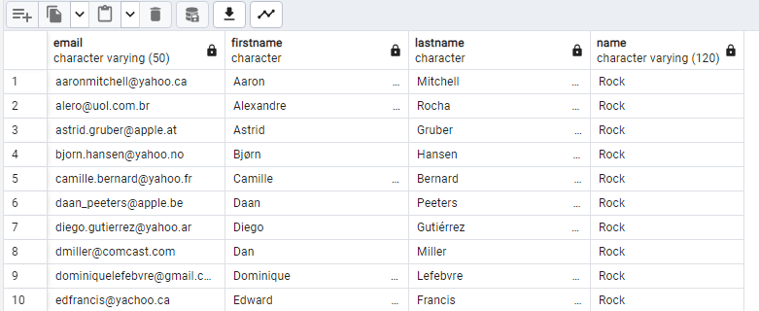
Moderate
Write query to return the email, first name, last name, & Genre of all Rock Music listeners. Return your list ordered alphabetically by email starting with A. (This is Solved in a different METHOD)
QUERY
Table

Slide 11
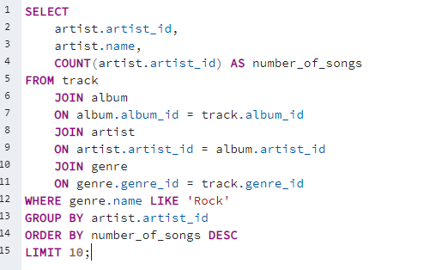
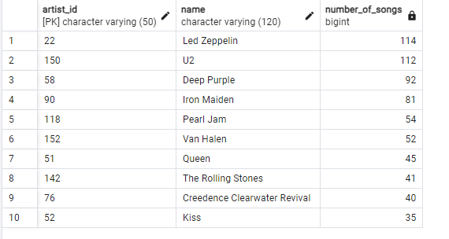
Moderate
Let's invite the artists who have written the most rock music in our dataset. Write a query that returns the Artist name and total track count of the top 10 rock bands.
QUERY
Table

Slide 12
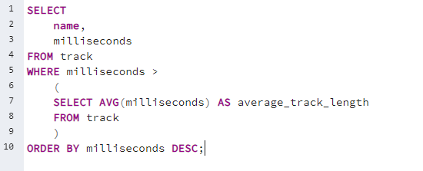
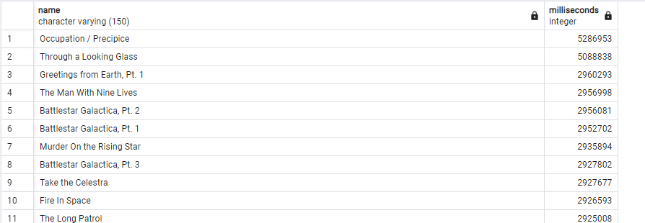
Moderate
Return all the track names that have a song length longer than the average song length. Return the Name and Milliseconds for each track. Order by the song length with the longest songs listed first.
QUERY
Table

Slide 13
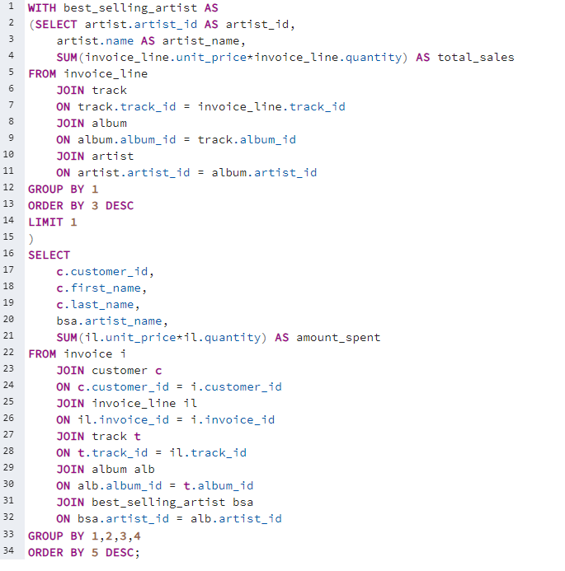
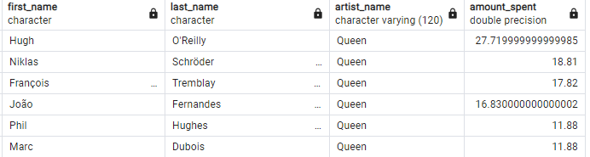
ADVANCED
QUERY
Find how much amount spent by each customer on artists? Write a query to return customer name, artist name and total spent First, find which artist has earned the most according to the Invoice Lines.
Now use this artist to find which customer spent the most on this artist. For this query, you will need to use the Invoice, Invoice Line, Track, Customer, Album, and Artist tables. Note, this one is tricky because the Total spent in the Invoice table might not be on a single product, so you need to use the Invoice Line table to find out how many of each product was purchased, and then multiply this by the price for each artist.
Table

Slide 14
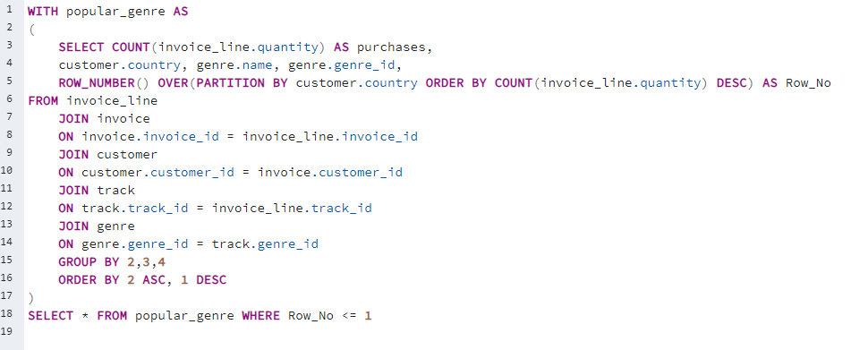
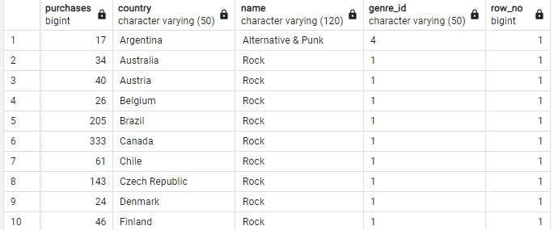
ADVANCED
QUERY
We want to find out the most popular music Genre for each country. We determine the most popular genre as the genre
with the highest amount of purchases. Write a query that returns each country along with the top Genre. For countries where the maximum number of purchases is shared return all Genres.
Table

Slide 15
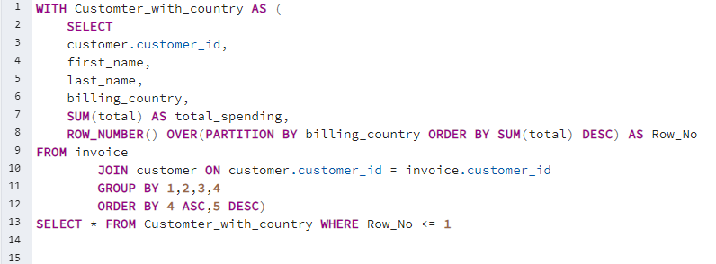
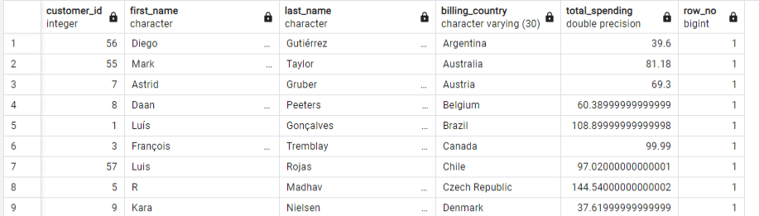
ADVANCED
QUERY
We want to find out the most popular music Genre for each country. We determine the most popular genre as the genre
with the highest amount of purchases. Write a query that returns each country along with the top Genre. For countries where the maximum number of purchases is shared return all Genres.
Table

Slide 16
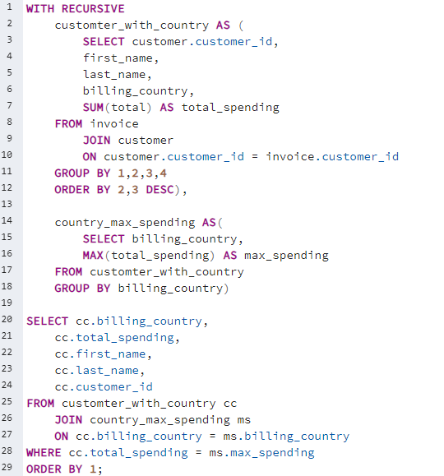
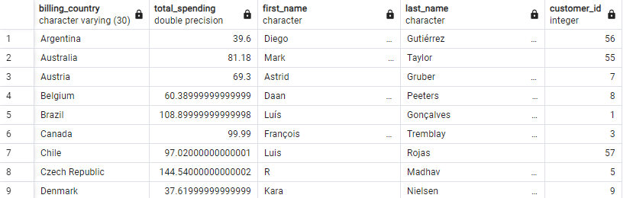
ADVANCED
Write a query that determines the customer that has spent the most on music for each country. Write a query that returns the country along with the top customer and how much they spent. For countries where the top amount spent is shared, provide all customers who spent this amount.
There are two parts in question first find the most spent on music for each country and second filter the data for respective customers.
QUERY
Table

Slide 17
Thank you

